Slide 1
Helsinki vs wELLINGTON
happiest cities comparison

Slide 2
Background & purpose
Background: world’s happiest city 2020 top 3: Helsinki , Aarhus, Wellington
Helsinki: second most northern capical city
Wellington: most southern capical city
Purpose:
discover the similarities and dissimilarities between Helsinki and Wellington, from the perspective of sub-districts clustering

Slide 3
Data
Data collection
Wikipedia
Foursquare PLACE API
geopy
Data preprocessing
Feature selection
one hot encoding

Slide 4
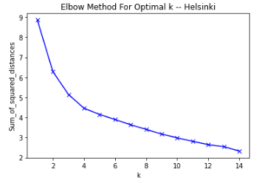
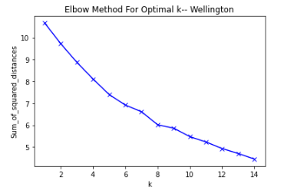
Methodology
K means clustering
Optimal K

Slide 5
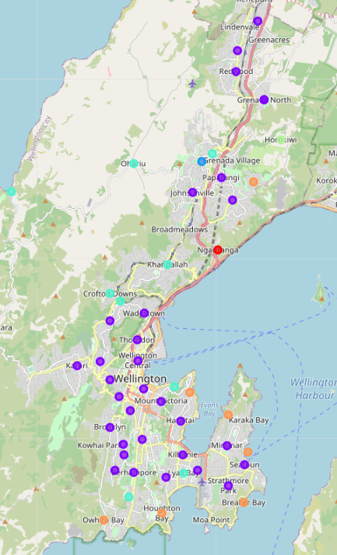
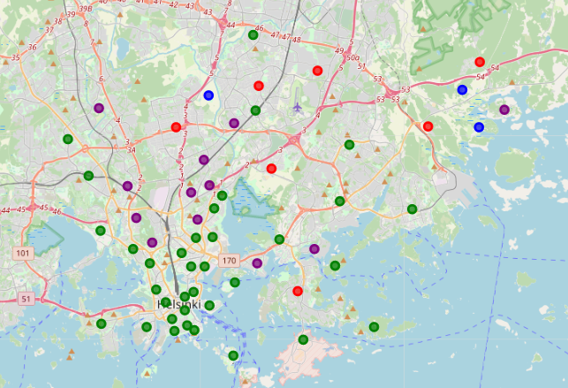
Results
4 clustering's in Helsinki
6 clustering's in Wellington

Slide 6
discussion
Similarity – cluster distribution
60%:15%:15%:rest

Slide 7
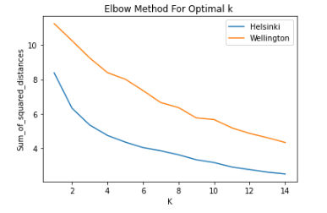
discussion
Difference
sub-districts are more alike in Helsinki, while more diversities are appearing in Wellington

